Slide 1

Git and GitHub
Prepared By:
Mohammed Abdo
Asmaa Ibrahim
Sara Younis
Supervised By :
Dr / Mohammed Nagy

Slide 2

firstly ,Git is not the Github (:

Slide 3

1-What is Git ?
Git is a free and open source distributed version control system designed to handle everything from small to very large projects with speed and efficiency“

Slide 4
SETUP & INIT
Configuring user information used across all local repositories.
git config --global user.name “[firstname lastname]” set a name that is identifiable for credit when review version history
git config --global user.email “[valid-email]” set an email address that will be associated with each history marker
git init initialize an existing directory as a Git repository

Slide 5
STAGE & SNAPSHOT Working with snapshots and the Git staging area
git status show modified files in working directory, staged for your next commit
git add [file] add a file as it looks now to your next commit (stage)
git reset [file] unstage a file while retaining the changes in working directory
git diff diff of what is changed but not staged
git diff –staged diff of what is staged but not yet committed
git commit -m “[descriptive message]” commit your staged content as a new commit snapshot

Slide 6
BRANCH & MERGE Isolating work in branches, changing context, and integrating changes
git branch list your branches. a * will appear next to the currently active branch
git checkout switch to another branch and check it out into your working directory
git merge [branch] merge the specified branch’s history into the current one
git log show all commits in the current branch’s history

Slide 7
SHARE & UPDATE Retrieving updates from another repository and updating local repos
git remote add [alias] [url] add a git URL as an alias
git merge [alias]/[branch] merge a remote branch into your current branch to bring it up to date
git push [alias] [branch] Transmit local branch commits to the remote repository branch
git pull fetch and merge any commits from the tracking remote branch

Slide 8
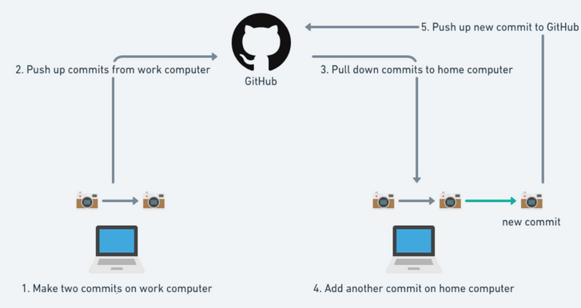
2- What Is GitHub?
Github is a a repository hosting service for Git While Git is a command line tool, GitHub provides a web-based graphical interface that works on top of GIT. It can also be treated as a social platform to share knowledge and work.

Slide 9
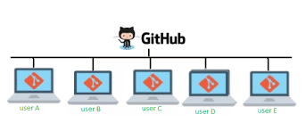
Briefly…

Slide 10



What's about GitHub?
By default, all projects are public and free. In you want a private project, then pay
You can clone any public repository, follow projects and developers, post comments, etc
It’s becoming the Facebook’s for developers

Slide 11
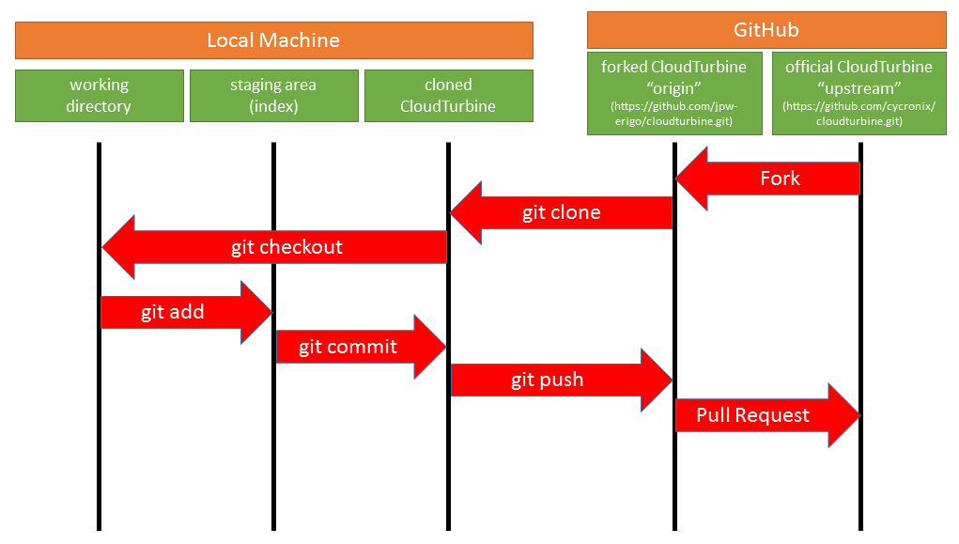

Slide 12
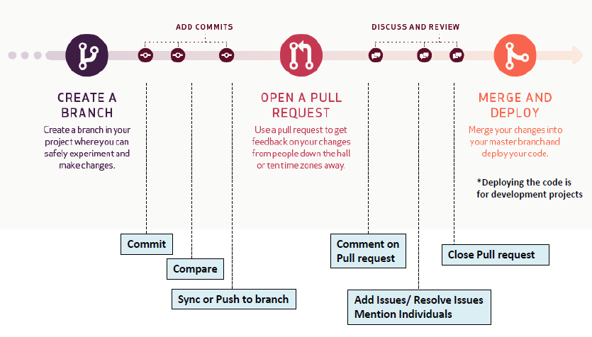
Understanding Github Workflow

Slide 13
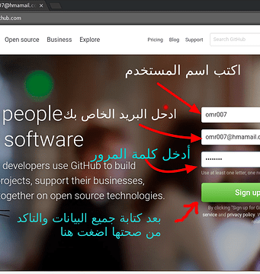
How to create an account on GitHub
1- Go to GitHub And record data
2- After completing the registration phase Click on the word "Continue" to continue

Slide 14
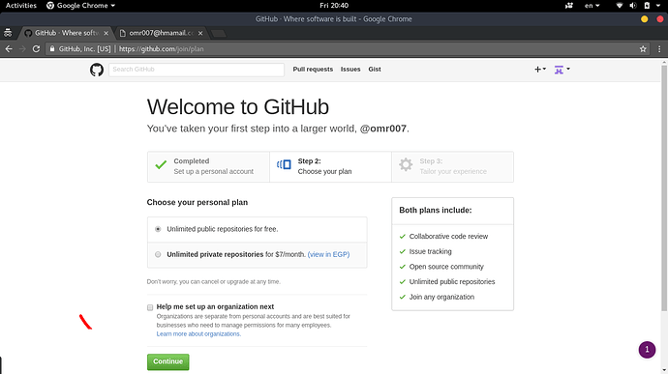
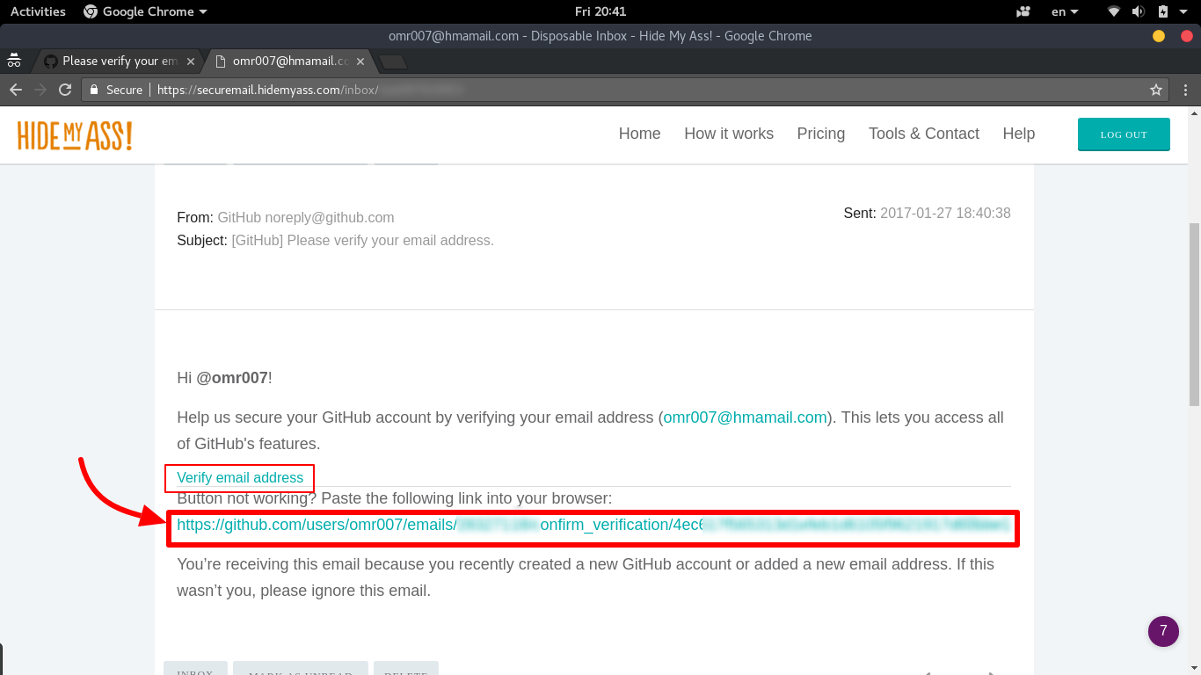
3- After completing the registration phase Click on the word "Continue" to continue
4- Go to your mail to activate your account

Slide 15
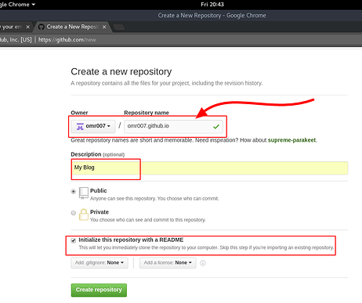

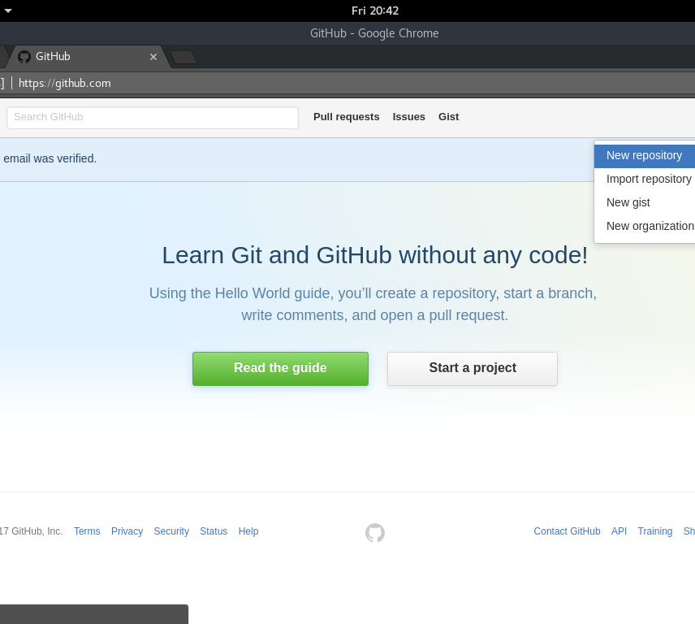
5- After clicking on the activation link from your mail, you will go to the "Get Hub" website and choose as in the following picture, which is about creating a new repository (New repository)
6- Type your username
--After completing all the stages, press (create repository)

Slide 16
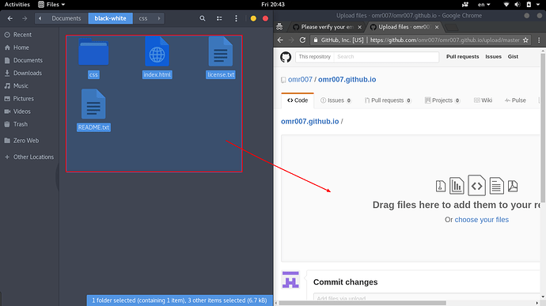
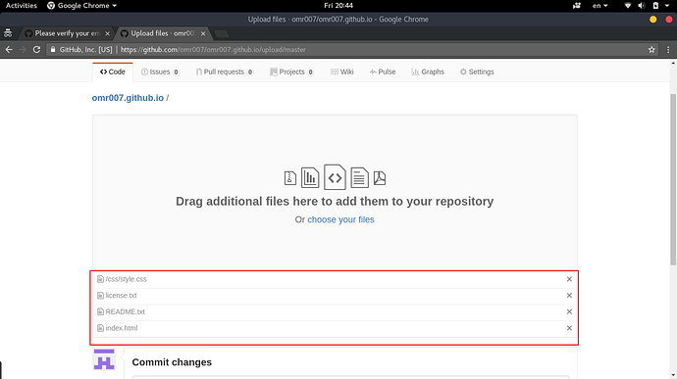
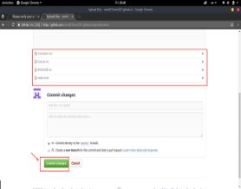
How to upload your project and files from git to GitHub
After completing the repository creation
you must now upload all your site files, Drag and drop your site files
It is the same if the files have been successfully uploaded
After making sure that all your files have been uploaded,
click on (Commit Changes)

Slide 17
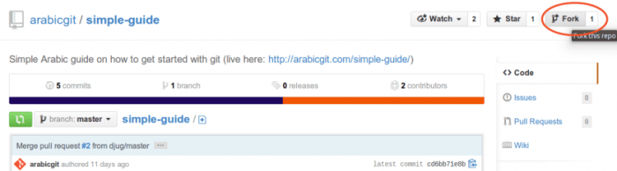
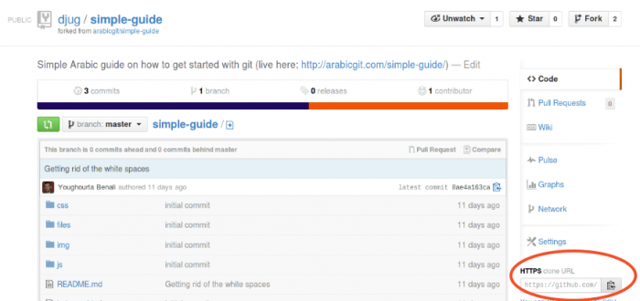
How to share your projects with team members
1.Copy the project to your account by clicking on the Fork button This process creates an
Exact replica of the original
repository on your GitHub account.
2. After that, clone this new repository on your local machine. Enter the directory you want
to clone the folder to
(cd path / to / folder)
and run the command git clone
followed by the repository address

Slide 18
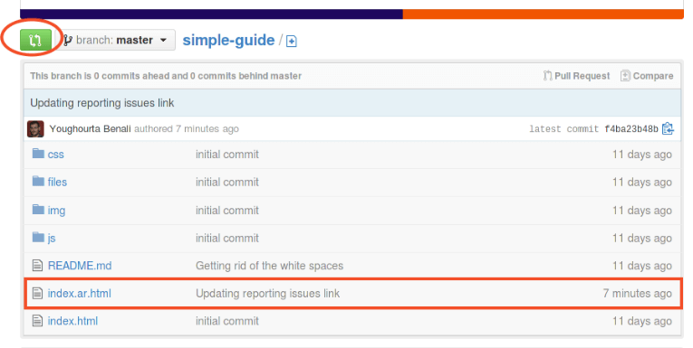
How to share your projects with team members
3. After you have obtained this copy, enter the changes you want and save those changes
4.Let's submit your changes to the staging area
( git add .) then make ( git commit )
5. Submit these changes to the repository
(git push origin master)
6. Returning to the personal repository page on GitHub, we will see the date of the last update of the modified files and a description of it.

Slide 19
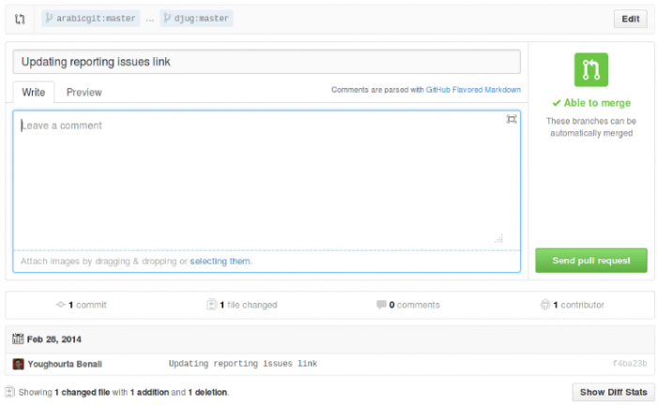
How to share your projects with team members
7. Click on the Create Pull request button, add any comments you want to the request, and then click the Send pull request button:

Slide 20
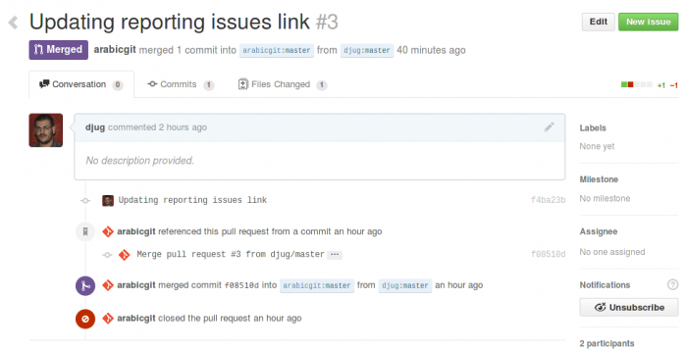
How to share your projects with team members
8. The project owner will receive a message regarding the changes you have made, and if they are accepted, you will receive a notification of them and your changes will appear on the original warehouse:

Slide 21
advantages and disadvantages of Git and Github?
Advantages:
Git is a distributed VCS that can be used offline.
Git's so ubiquitous that most other developers have familiarity with it, a lot of open source projects are hosted on GitHub, so it's a great place to find and contribute to those projects.
GitHub also incorporates 3rd party integrations (such as kanban tracking and continuous integration) to make workflows easier.
disadvantage
The main disadvantage with both Git and GitHub is that they both have a fairly steep learning curve.

